Slide 1

Project (CAC)³
Prof. Armineh Noravian
Ruth, Alex, James, Sonja, Elijah, Robert, Ella, Norma, Ralph, Jordan, and Micky
Notes:
Ruth

Slide 2
Collaboration with Dine College
Prof. Demetra Skaltsas
Jessica Begay and Nicole Vann
Notes:
Ruth

Slide 3
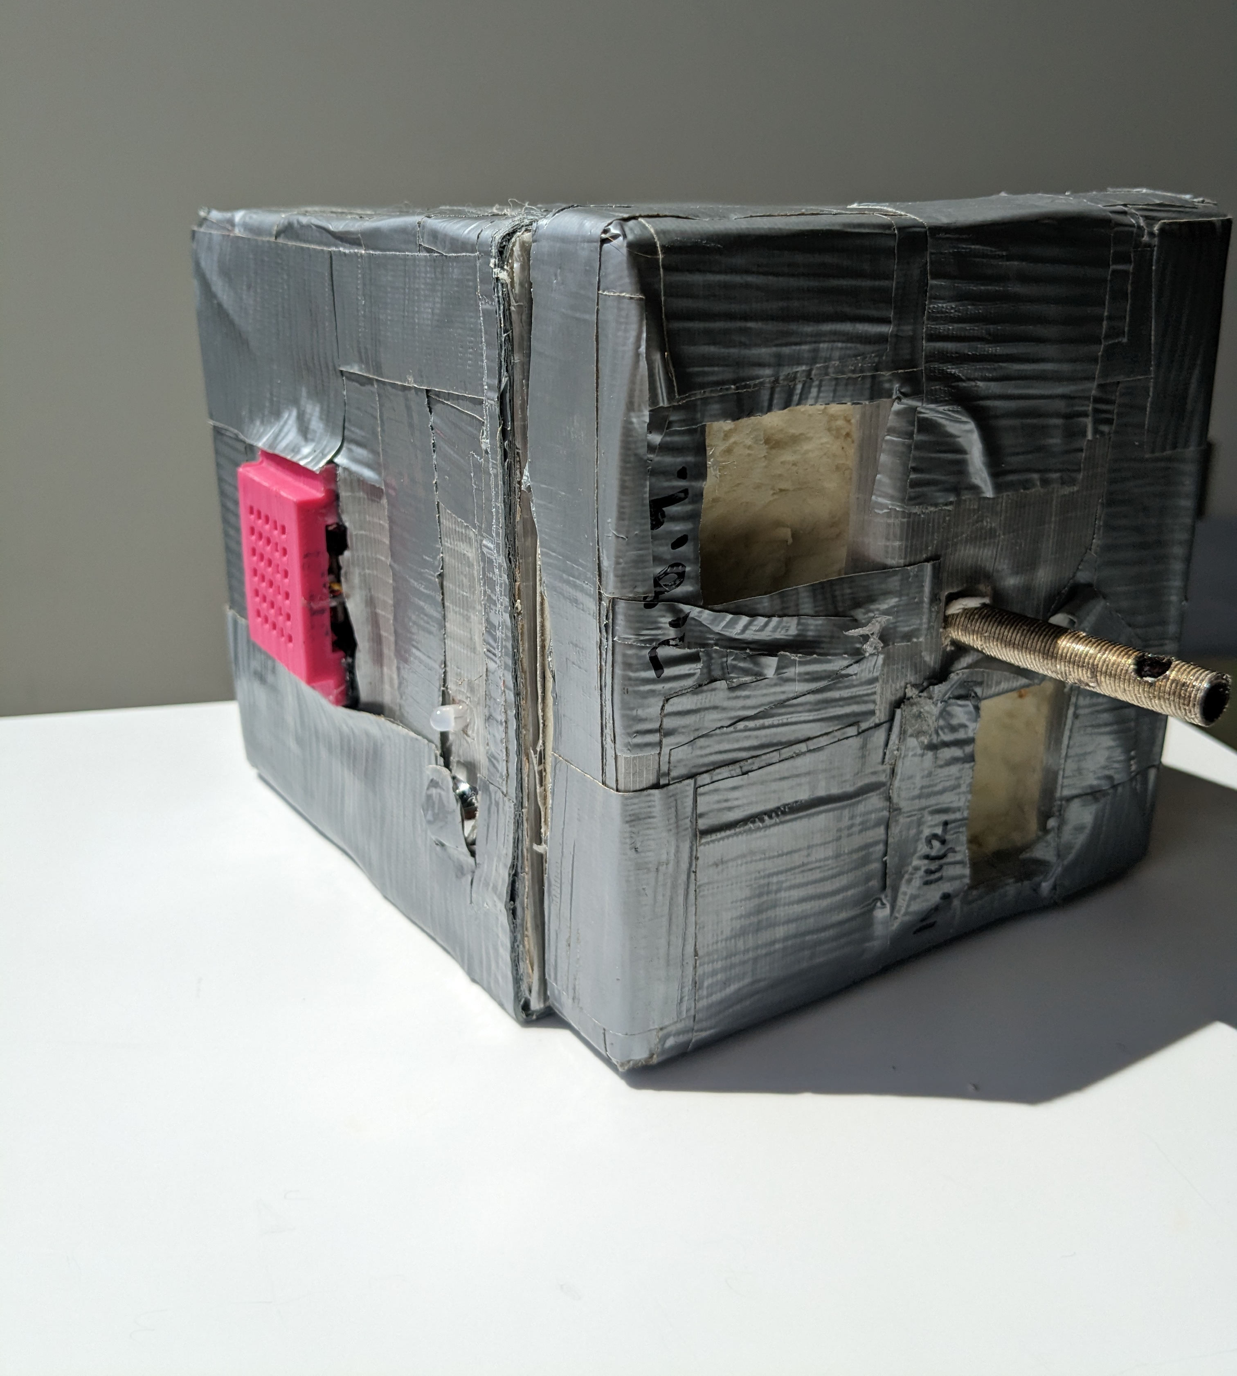
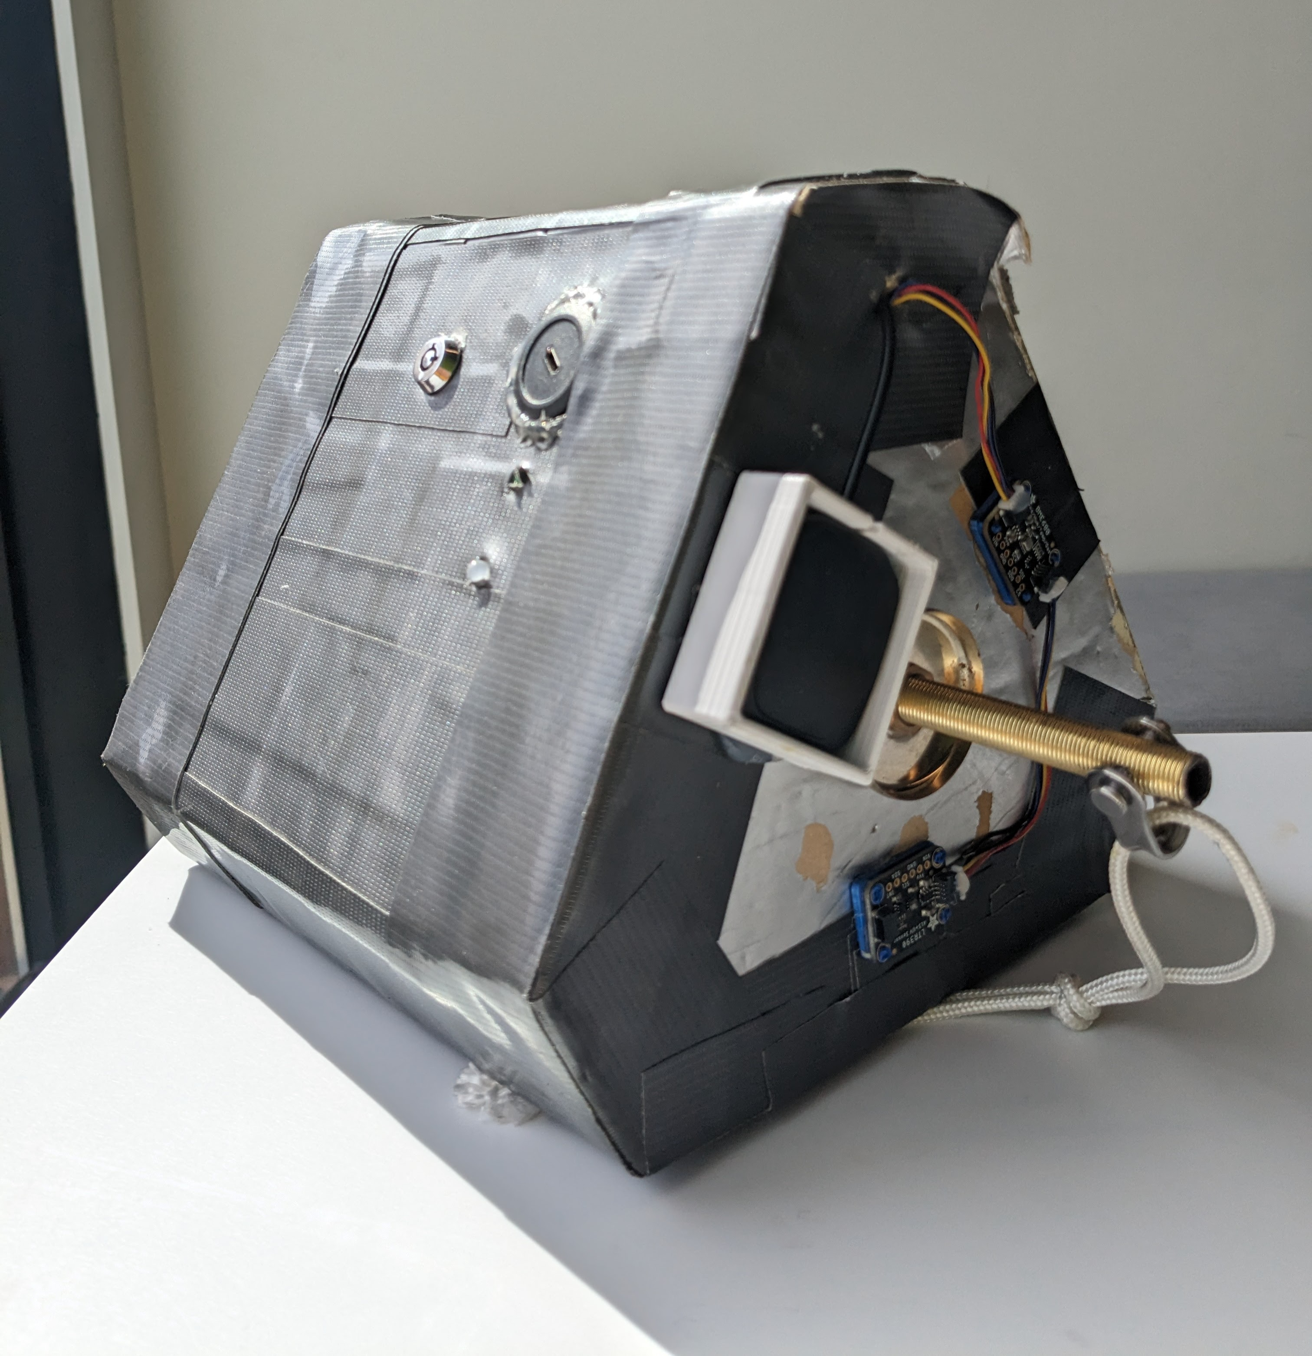
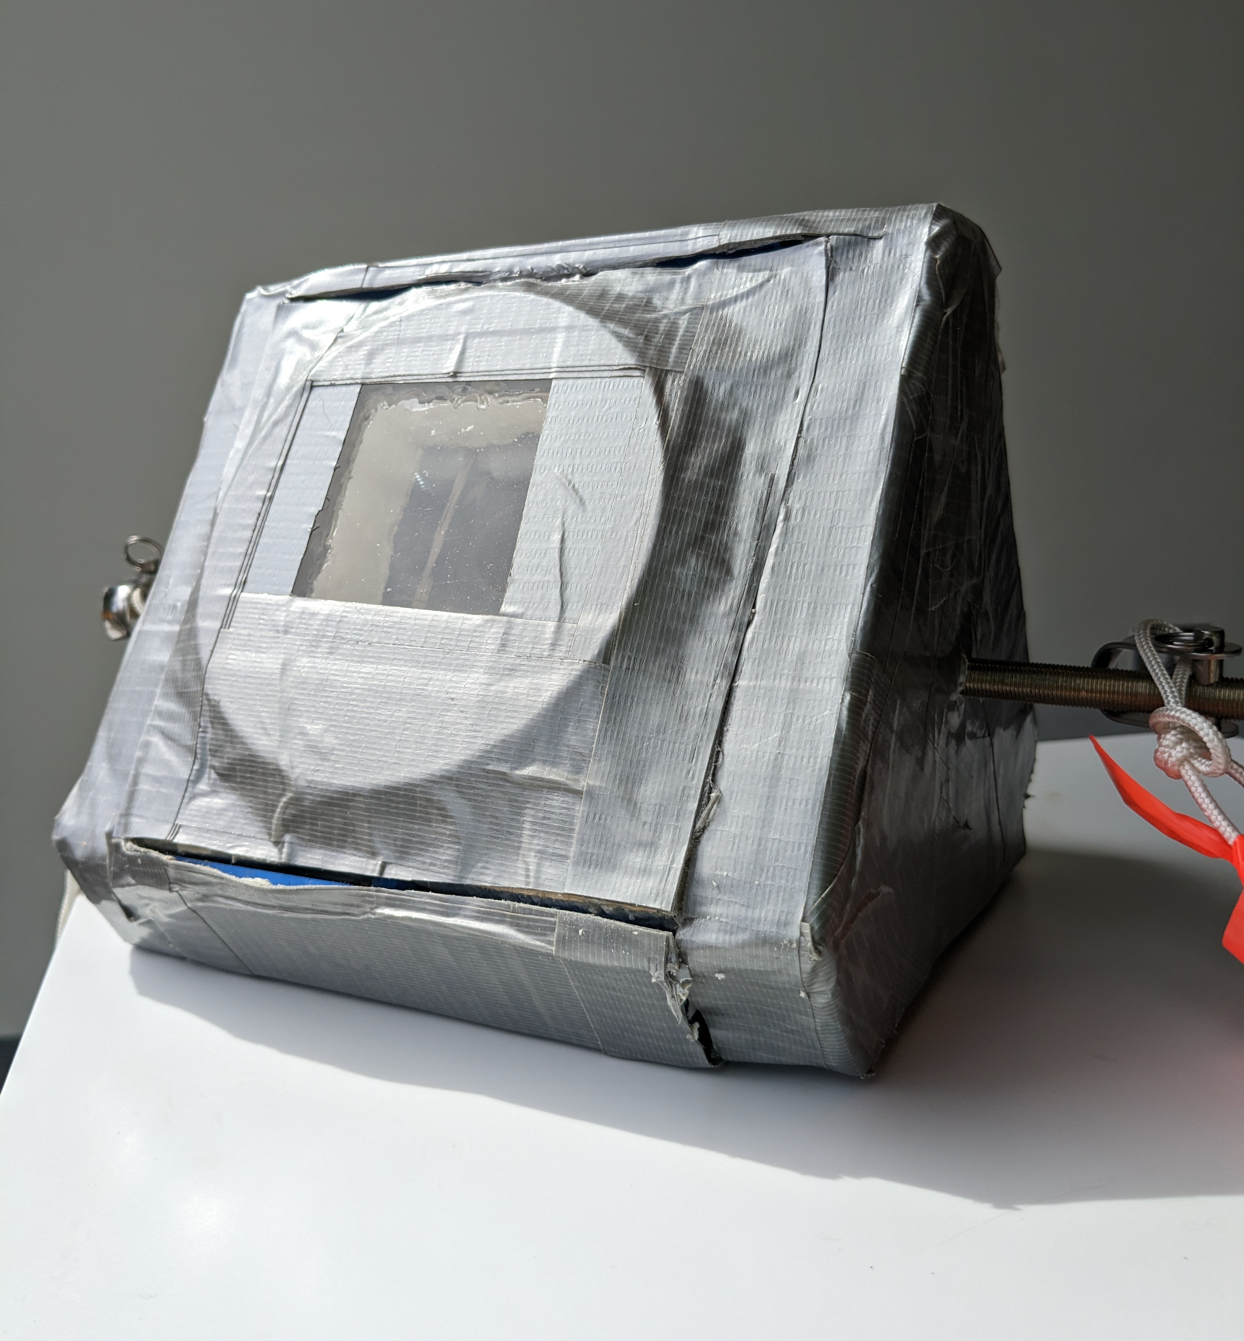



Three Payloads, Three Teams
Owls
Honey Badgers
Raptors
Notes:
Ruth

Slide 4
Owls
Research Question:
What is the difference in temperature, humidity, and altitude within the layers of the atmosphere?
Collaboration with Dine College
Alex, Ruth, Norma
Notes:
Norma

Slide 5
Conclusion
Seeds and payload survived
Review and debug the code thoroughly
Design a more accessible and smaller box
Consider other microcontrollers to reduce space

Slide 6
Research Questions:
How much acceleration will the payload experience?
What are the UV levels that the seeds will be exposed to?
Can GPS track the payload?
The measurements will include acceleration, UV, and location.
Honey Badgers
Elijah, Robert, Ella, Micky, Sonja
Notes:
Norma

Slide 7
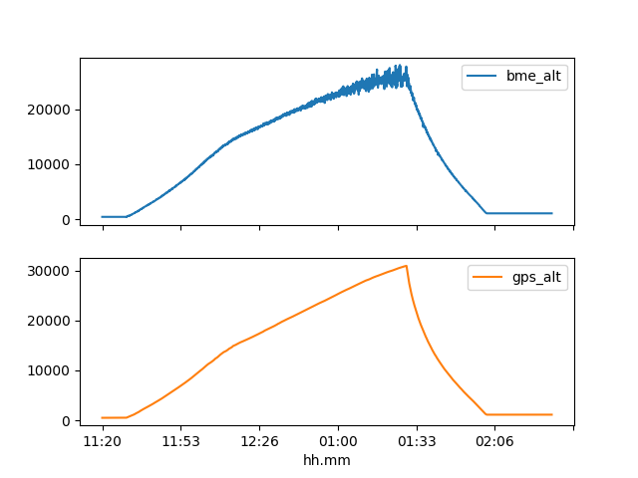
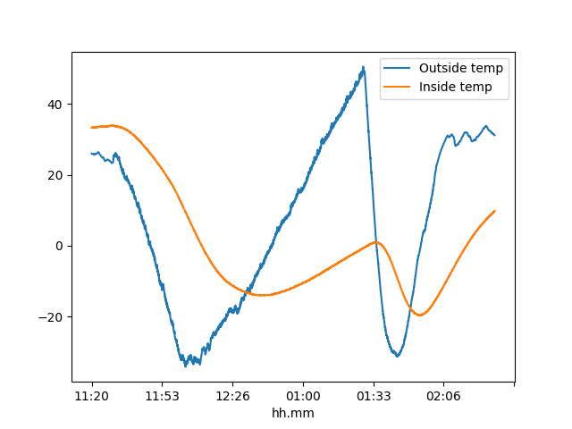
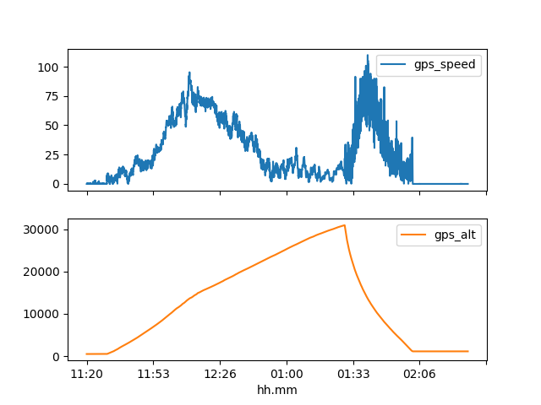
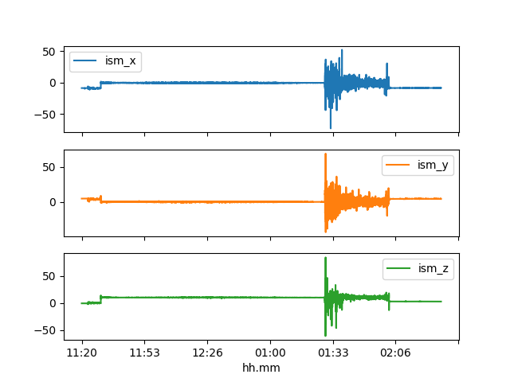
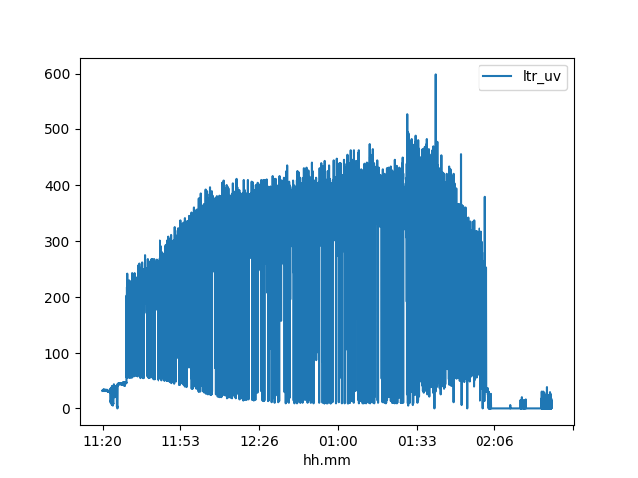
Results
Altitude
Temperature
Speed and Altitude
Acceleration
UV
Notes:
Pressure altitude was less accurate than GPS altitude.
The one inch foam we used to construct the payload with helped stabilize the temperature inside the box relative to the outside the box.
The only area in which the payload had an increased z acceleration when ascending. When descending though, acceleration data was all over the place.

Slide 8
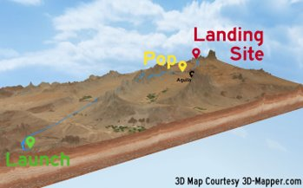
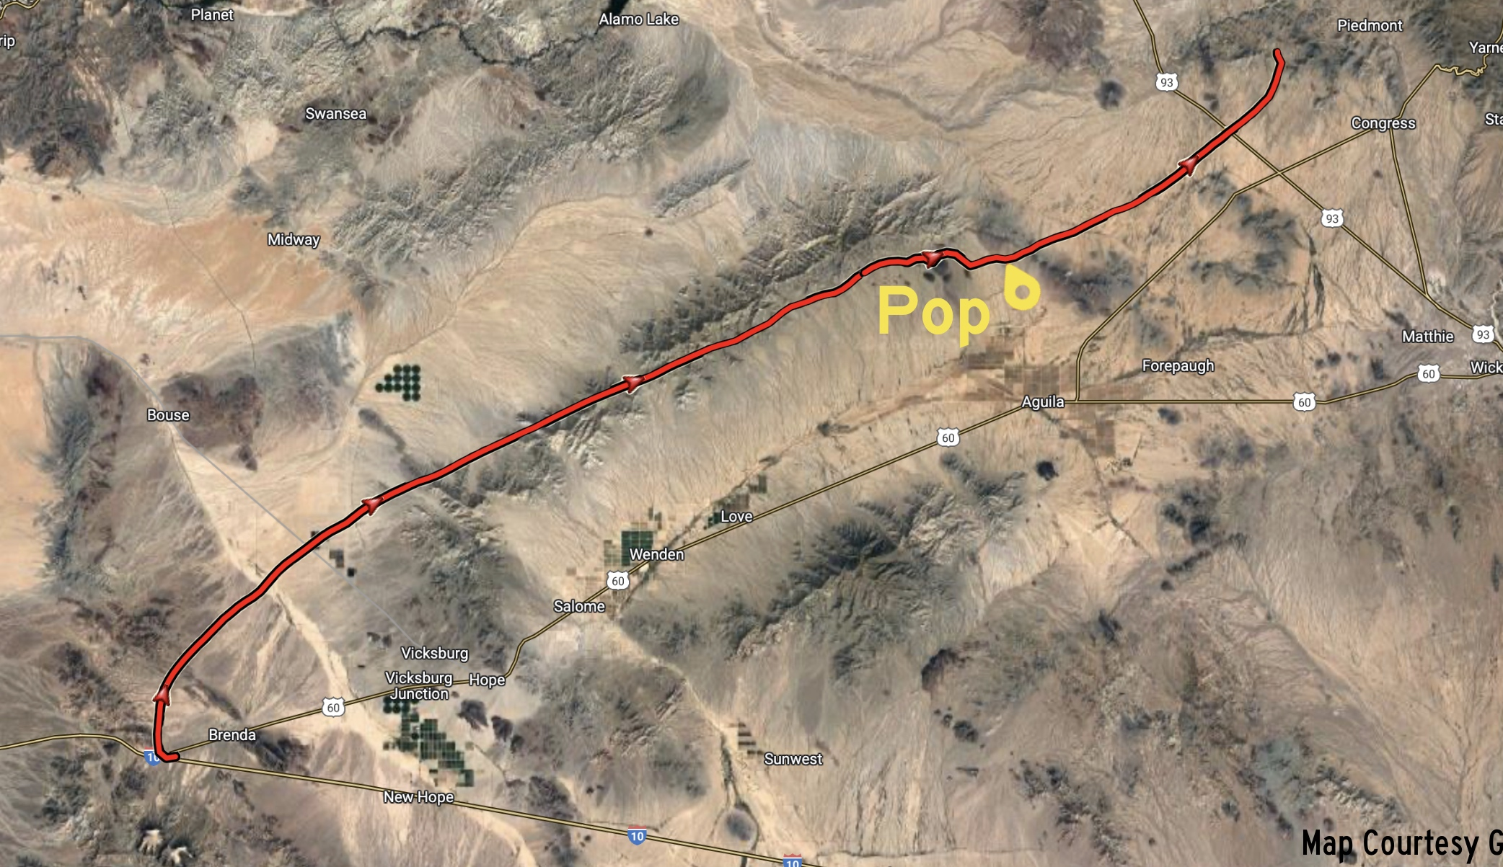
Conclusion
Thermal design succeeded
GPS accuracy exceeded the 5 meters quoted by manufacture
UV Sensor:
  Unclear data, possibly due to location on top of box.
  Devise a way to get useful data
  Test different sensors to determine which gives best results
Notes:
Original heating pad system failed- the battery was destroyed during testing

Slide 9
Research Question:
How can we create a camera system that, despite the extreme conditions, still captures quality video/images?
Raptors
James, Ralph, Jordan
Notes:
Norma

Slide 10
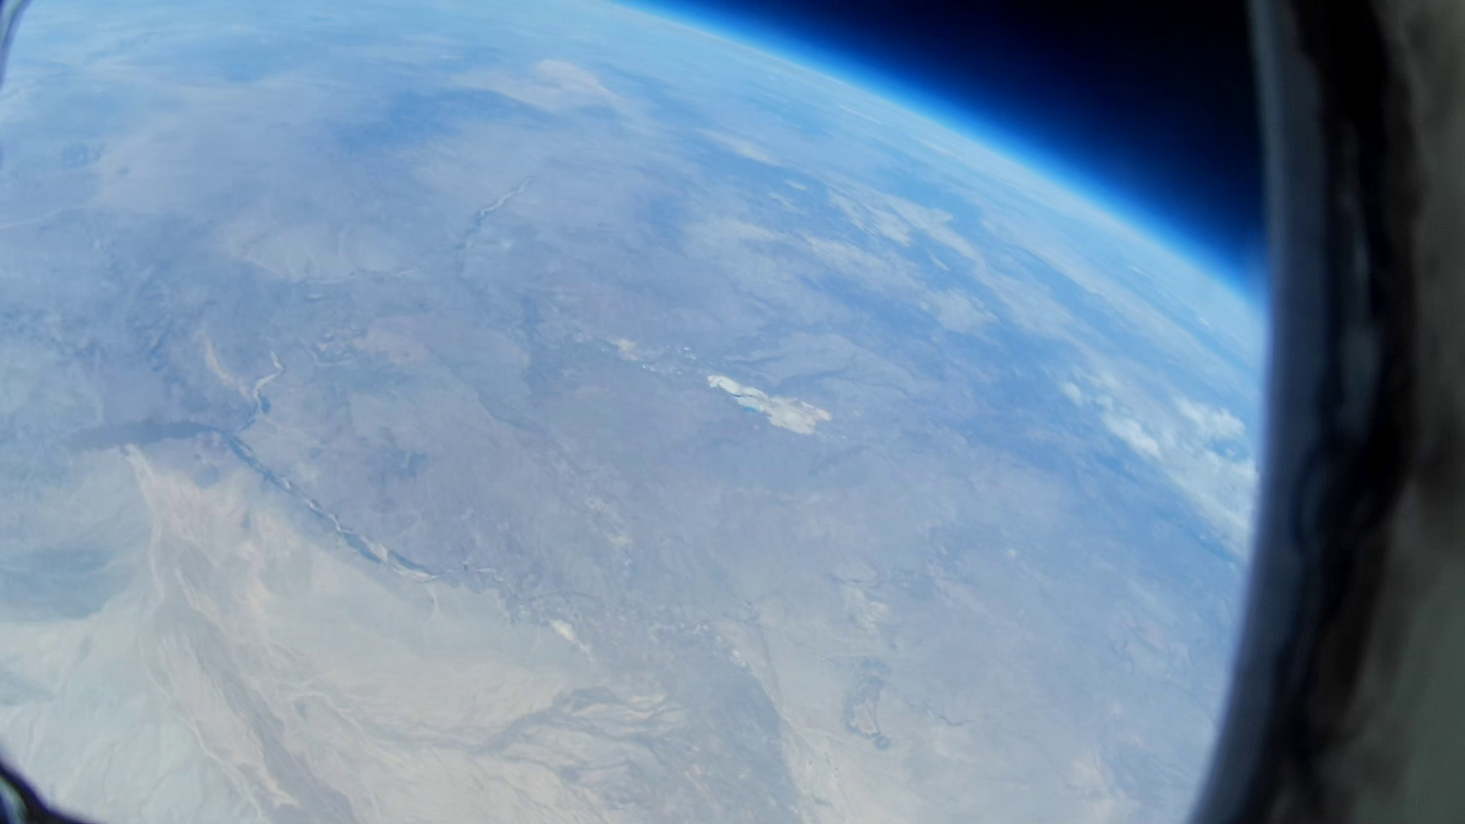
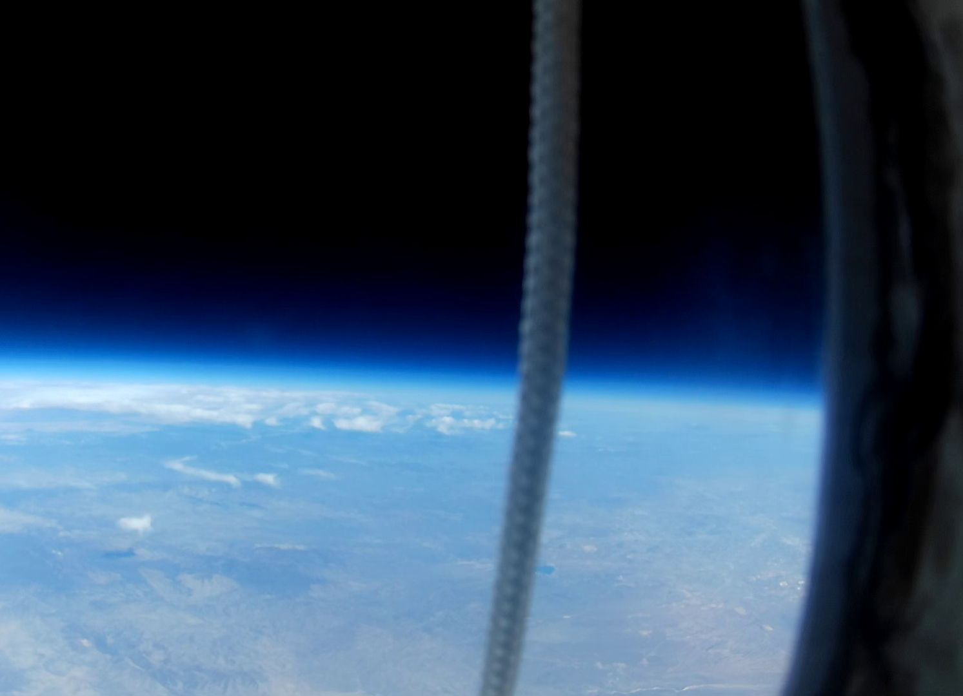
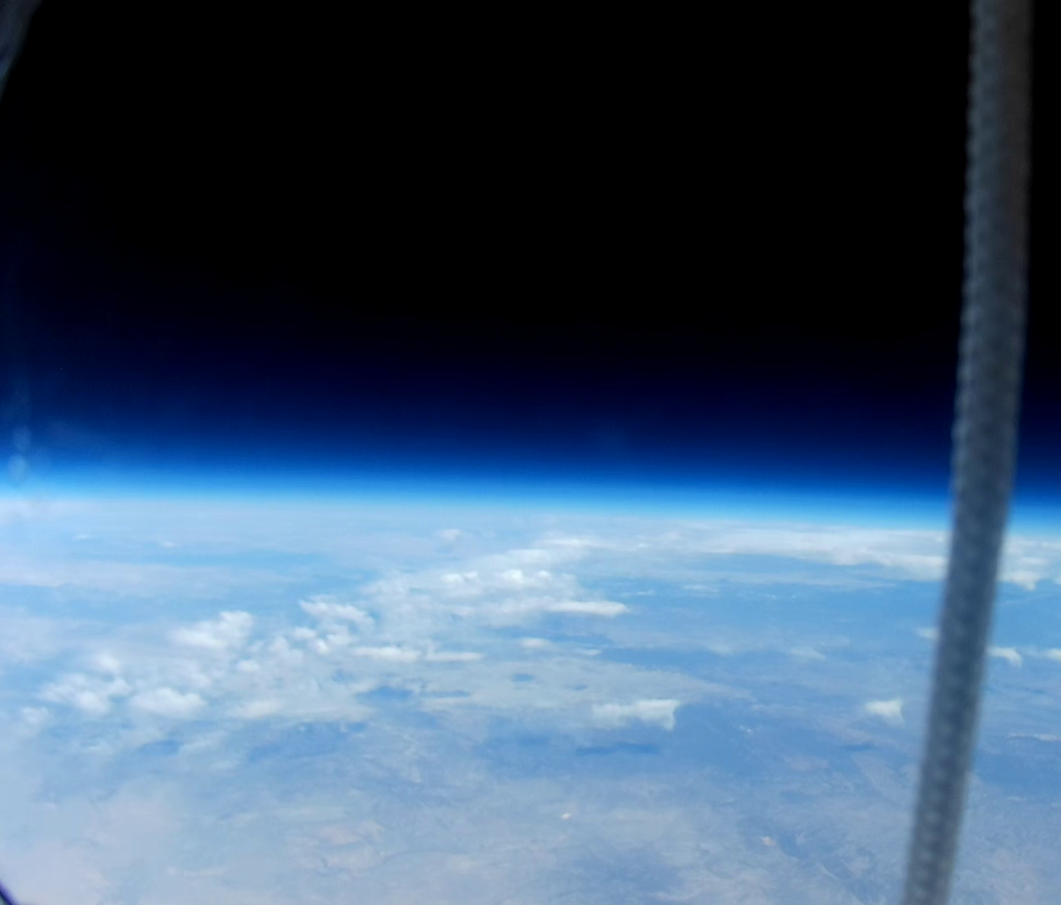
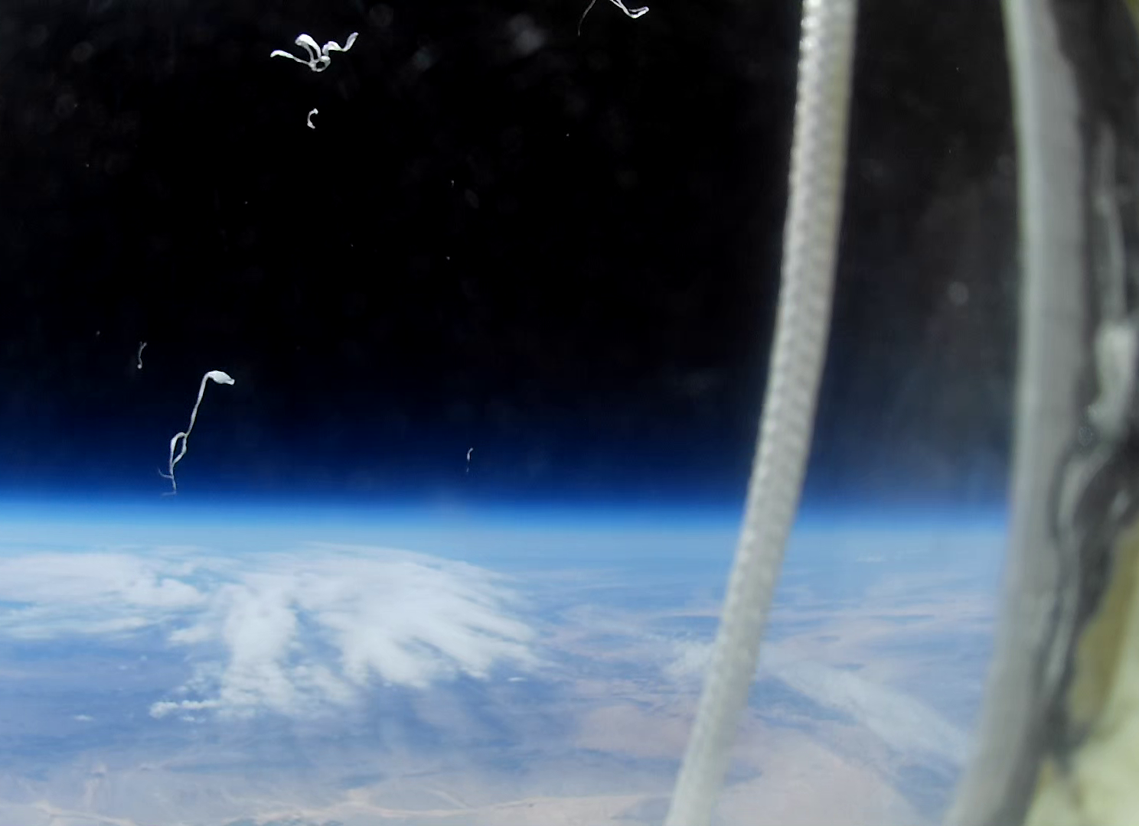
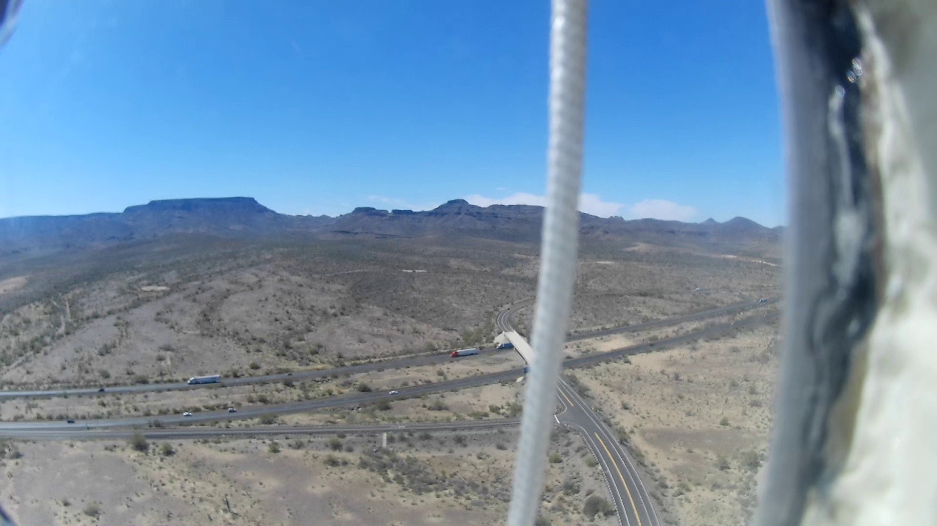
Results

Slide 11
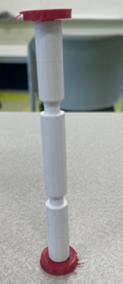
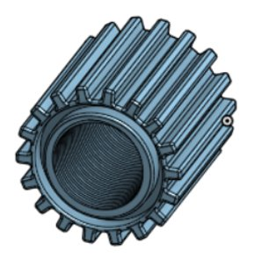
Conclusion
Clear video footage
Internal camera stabilization system succeeded
Do more testing tailored to specific predicted issues including:
  Condensation outside

Slide 12



Special Thanks To:
Michelle Coe
Dine College
ANSR
ASCEND
Our Website:
https://sites.google.com/view/cac3/home
Notes:
Mention the website

